Slide 1
Demand Response for heating and cooling purpose in smart house.
Herr Abhik Ghosh

Slide 2
Contents
Motivation.
Private Household heating and cooling system .
Components
Price Function
Comparisons of demand response
Saving in Electric bill

Slide 3
1.Motivation .
Private Household heating and cooling system .
Components
House model
Heat pump
Controller
Heat exchanger
Circulation pump
Weather disturbances

Slide 4
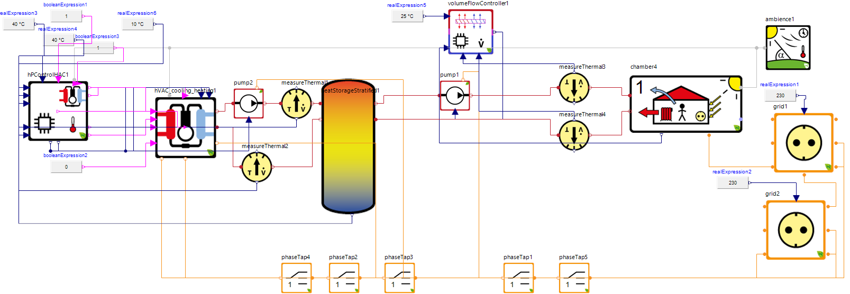
2.Housing system in SimulationX .

Slide 5
3. Components
Thermal system
Household system
Heatpump

Slide 6
4. Price Function

Slide 7
Algorithm of Pricing function.

Slide 8
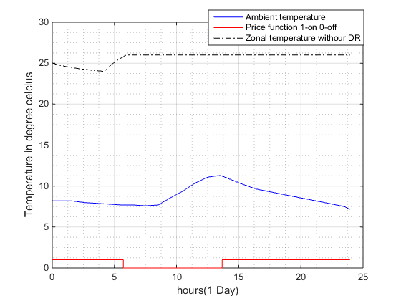
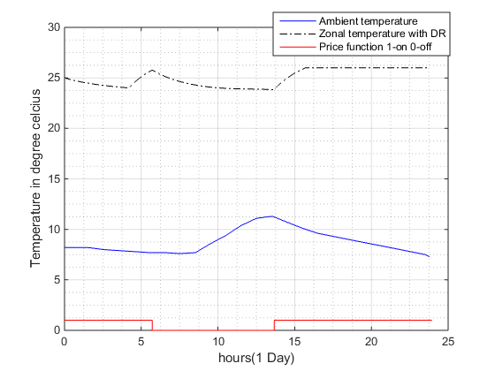
5. Comparisons
Zonal temperature inside the house (24 hours)
Demand response
Without demand response

Slide 9
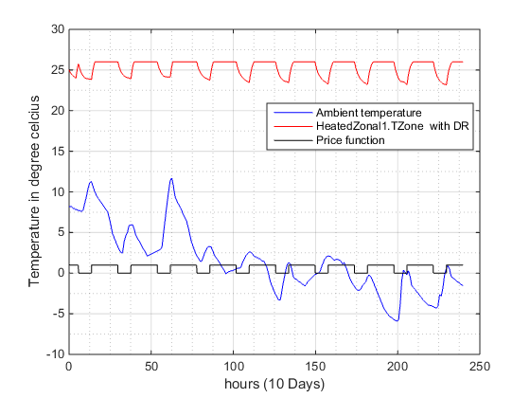
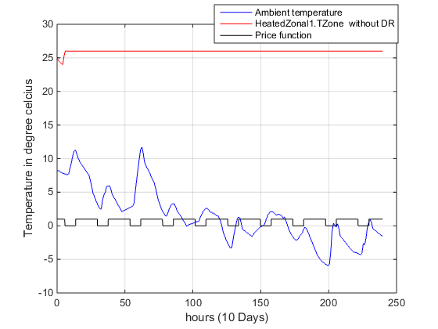
Zonal temperature inside the house
10 days analysis
Demand response
Without demand response

Slide 10
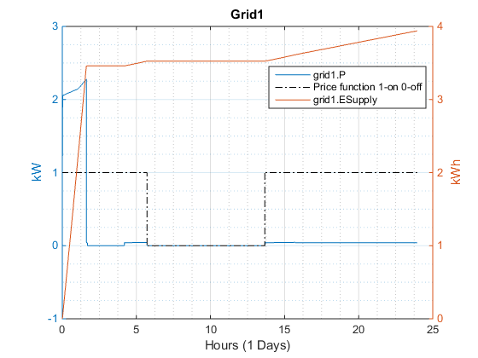
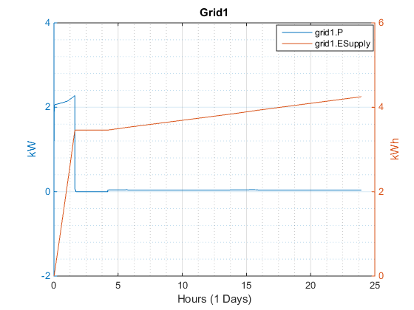
Grid generation
24 hours analysis
Without demand response
Demand response

Slide 11
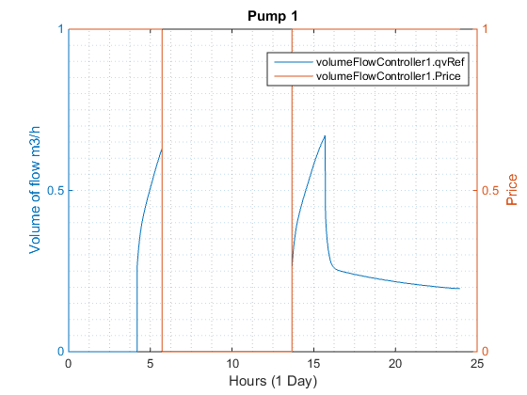
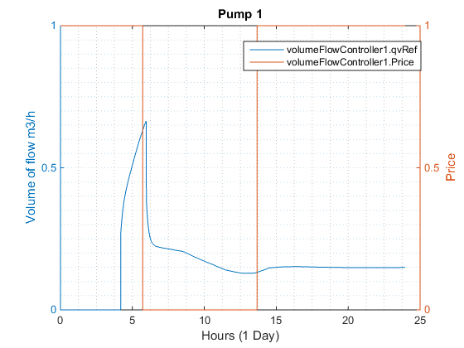
Heatpump response
24 hours analysis
Demand response
Without demand response

Slide 12
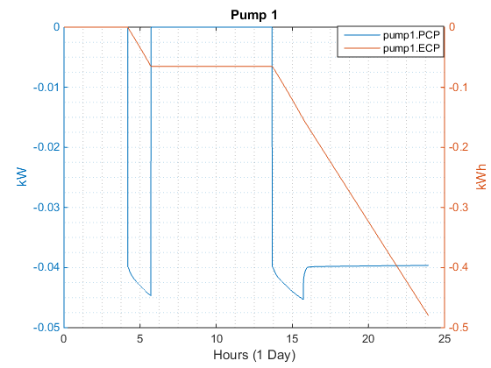
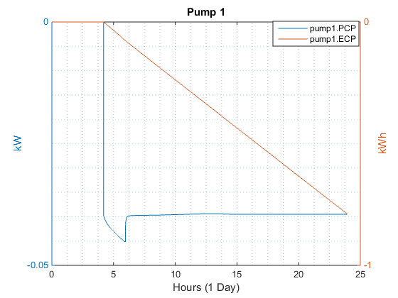
Power and Energy
Demand response
Without demand response

Slide 13
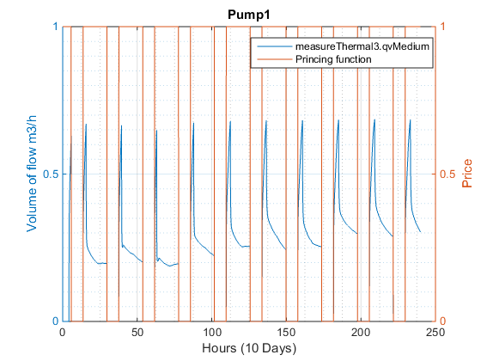
10 days analysis
Demand response
Without demand response

Slide 14

6. Saving in Electric bill
10 days analysis
Total money paid in electricity bill = $Price from grid ∗energy consumed.$
percentage of amount saved is $\frac{Electricity bill in without DR− with DR}{ Electricity bill in without DR}\%$

Slide 15
Conclusion

Slide 16
Thanks for your Attention

